Slide 1
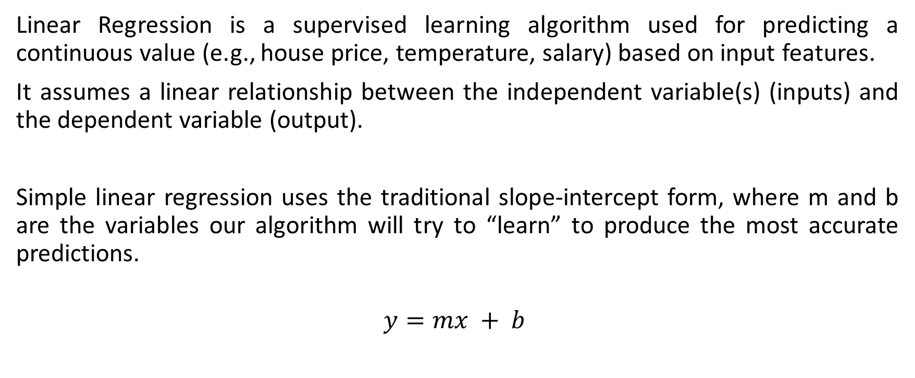
Linear Regression
Linear Regression is a supervised learning algorithm used for predicting a continuous value (e.g., house price, temperature, salary) based on input features.
It assumes a linear relationship between the independent variable(s) (inputs) and the dependent variable (output).
Simple linear regression uses the traditional slope-intercept form, where m and b are the variables our algorithm will try to “learn” to produce the most accurate predictions.
$$y=mx + b$$

Slide 2
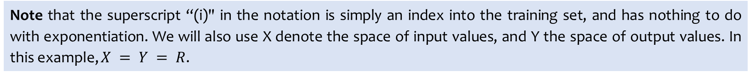
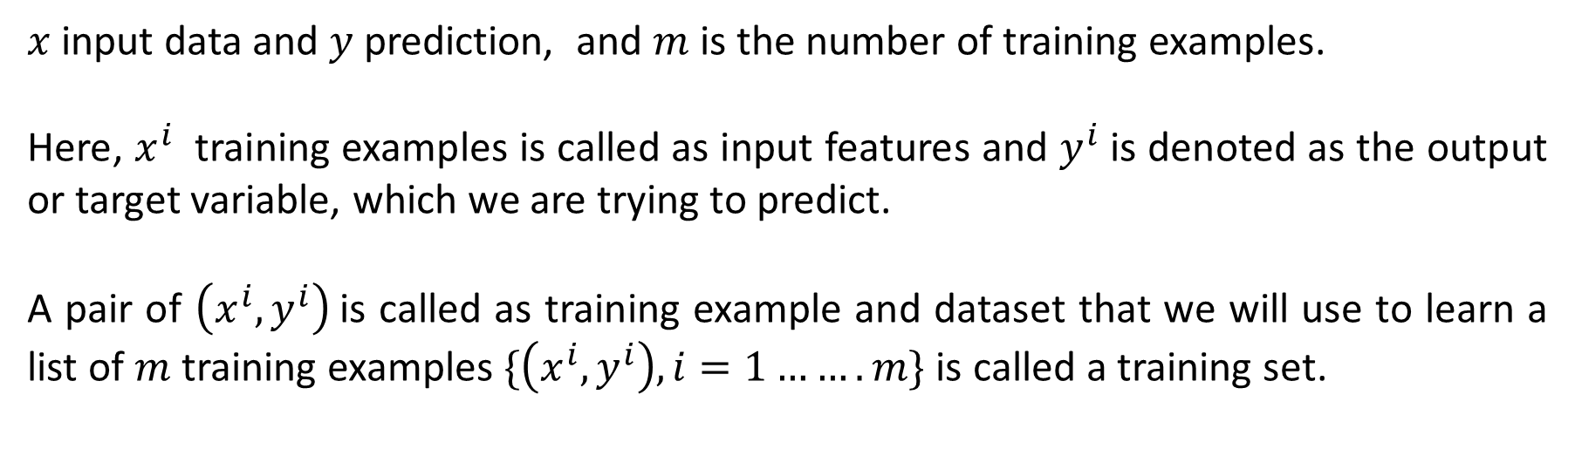
$x$ input data and $y$ prediction, and $m$ is the number of training examples.
Here, $x^{i}$ training examples is called as input features and $y^{i}$ is denoted as the output or target variable, which we are trying to predict.
A pair of $\left(x^{i}, y^{i}\right)$is called as training example and dataset that we will use to learn a list of $m$ training examples $\{\left(x^{i}, y^{i}\right), i=1…….m\}$ is called a training set.
Note that the superscript “(i)" in the notation is simply an index into the training set, and has nothing to do with exponentiation. We will also use X denote the space of input values, and Y the space of output values. In this example, $X = Y = R$.

Slide 3
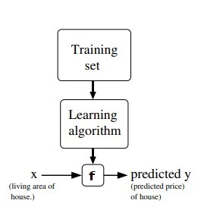
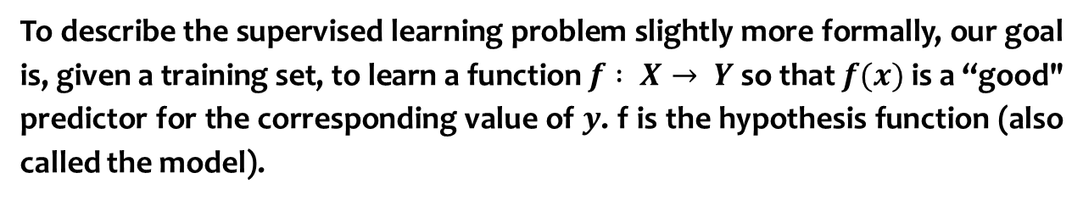
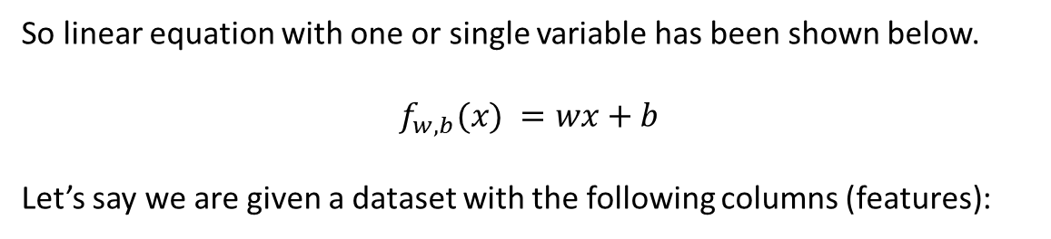
To describe the supervised learning problem slightly more formally, our goal is, given a training set, to learn a function $f : X→ Y$ so that $f(x)$ is a “good" predictor for the corresponding value of $y$. f is the hypothesis function (also called the model).
So linear equation with one or single variable has been shown below.
$$f_{w,b}(x) =wx+b$$
Let’s say we are given a dataset with the following columns (features):
Company | Radio ($) (x) | Sales (y)
Amazon | 37.8 | 22.1
Google | 39.3 | 10.4
Facebook | 45.9 | 18.3
Apple | 41.3 | 18.5

Slide 4
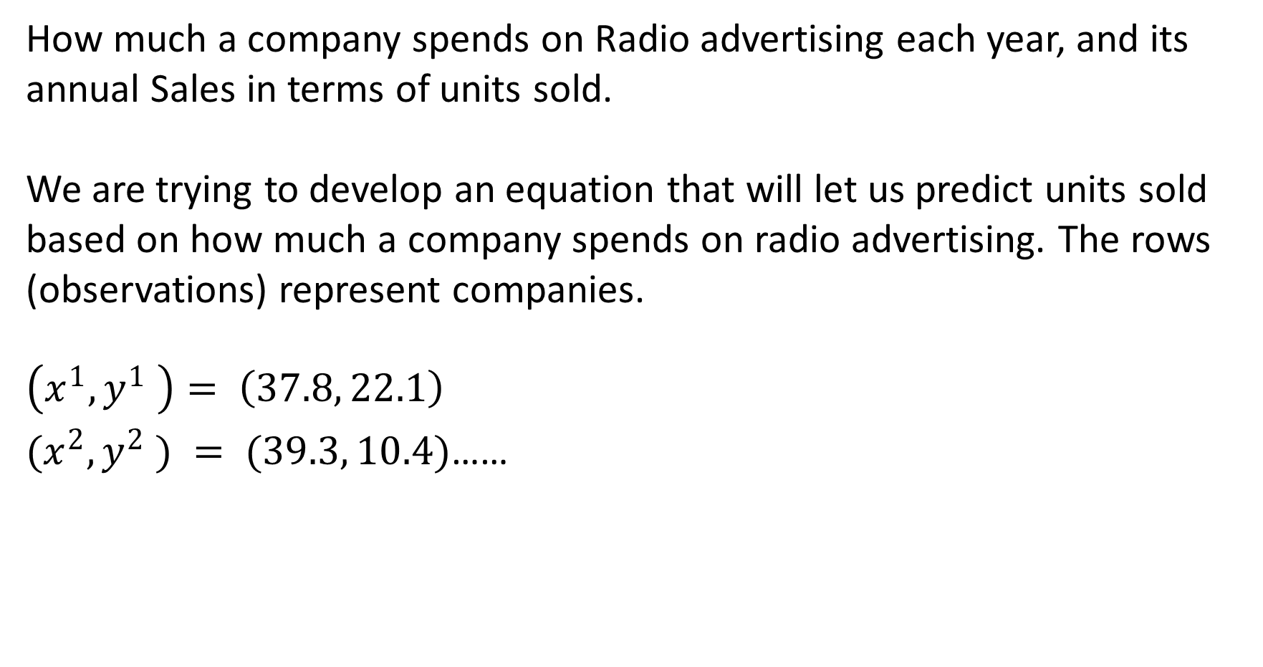
How much a company spends on Radio advertising each year, and its annual Sales in terms of units sold.
We are trying to develop an equation that will let us predict units sold based on how much a company spends on radio advertising. The rows (observations) represent companies.
$$\left(x^{1}, y^{1} \right)= \left(37.8, 22.1\right)$$
$(x^{2}, y^{2} ) = (39.3, 10.4)$……

Slide 5
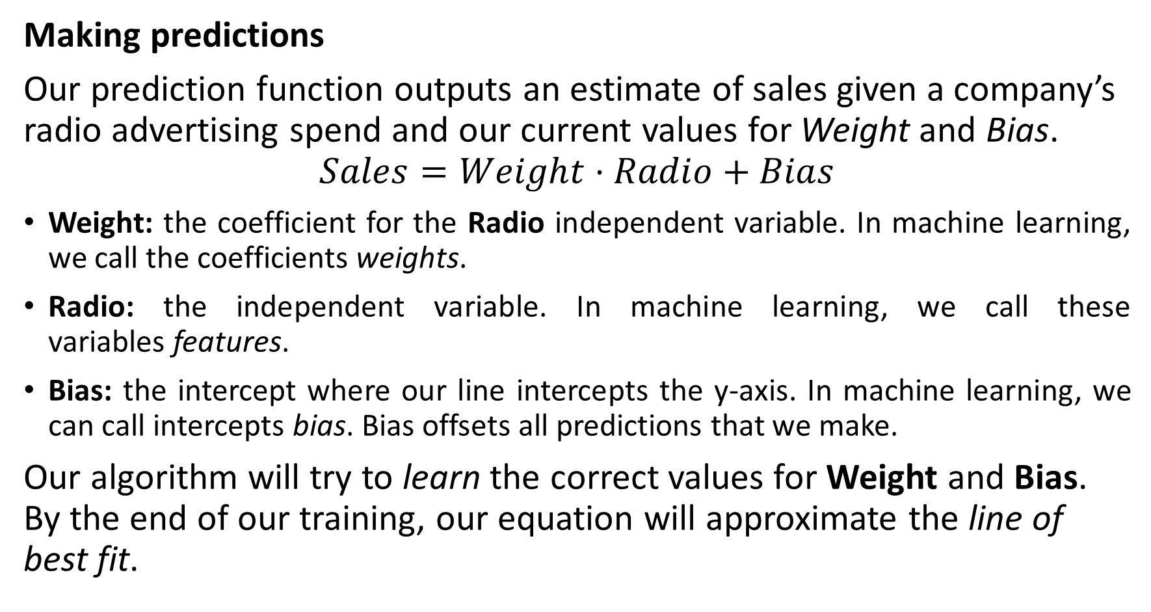
Making predictions
Our prediction function outputs an estimate of sales given a company’s radio advertising spend and our current values for Weight and Bias.
$$Sales=Weight⋅Radio+Bias$$
Weight: the coefficient for the Radio independent variable. In machine learning, we call the coefficients weights.
Radio: the independent variable. In machine learning, we call these variables features.
Bias: the intercept where our line intercepts the y-axis. In machine learning, we can call intercepts bias. Bias offsets all predictions that we make.
Our algorithm will try to learn the correct values for Weight and Bias. By the end of our training, our equation will approximate the line of best fit.

Slide 6
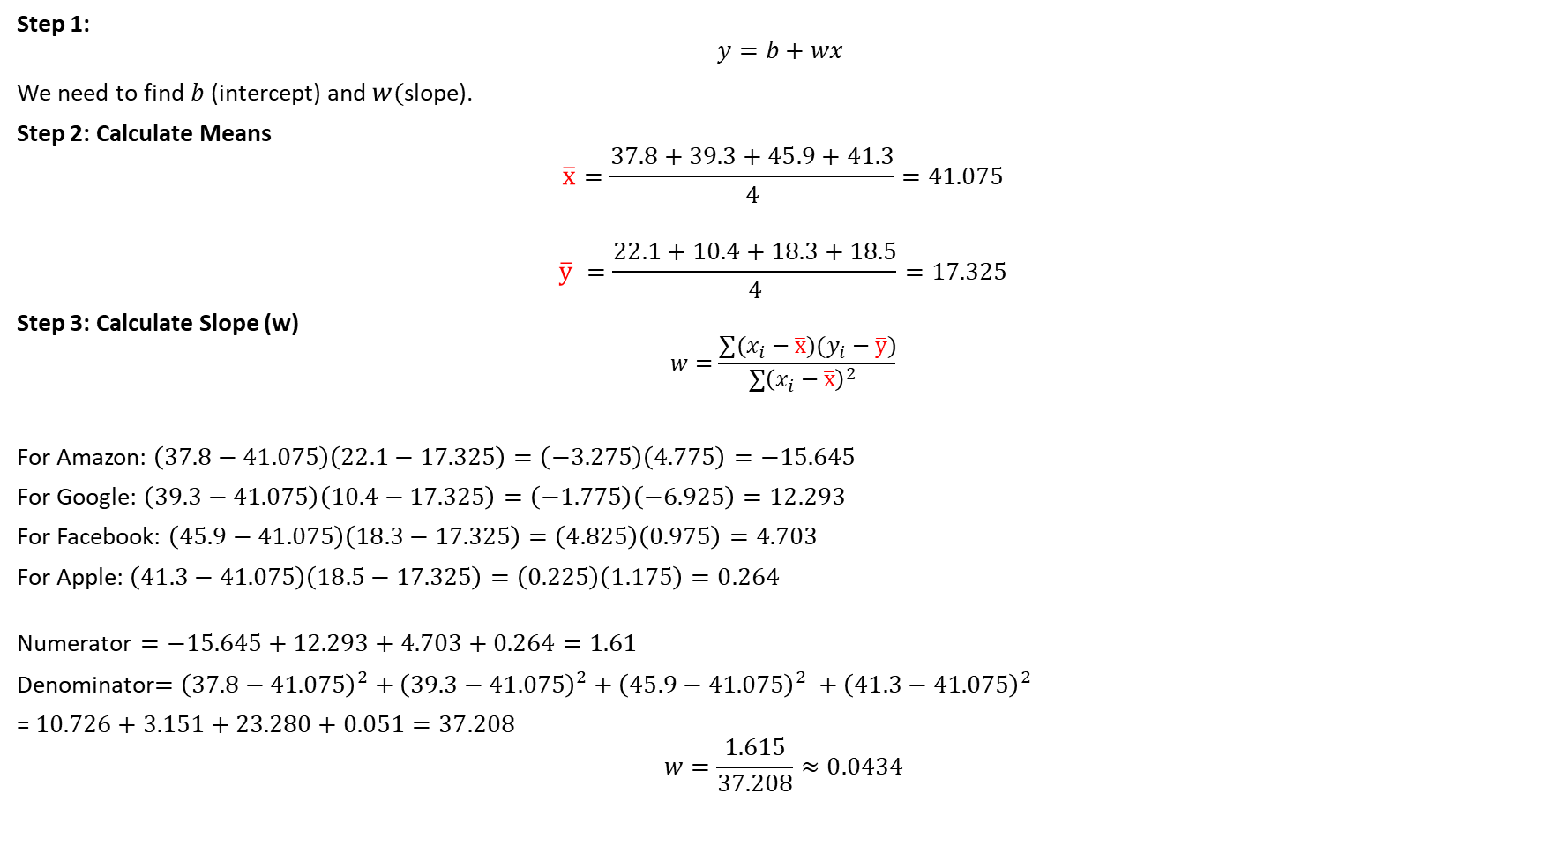
Step 1:
$$y=b​+w​x$$
We need to find$b$ (intercept) and $w($slope).
Step 2: Calculate Means
$$\overline{x}=\frac{37.8+39.3+45.9+41.3}{4}=41.075$$
$$\overline{y} =\frac{22.1+10.4+18.3+18.5}{4}=17.325$$
Step 3: Calculate Slope (w)
$$w​=\frac{∑(x_{i}​−\overline{x})(y_{i}​−\overline{y}​)}{∑{\left(x_{i}​−\overline{x}\right)}^{2}​ }$$
For Amazon: $\left(37.8−41.075\right)\left(22.1−17.325\right)=\left(−3.275\right)\left(4.775\right)=−15.645$
For Google: $\left(39.3−41.075\right)\left(10.4−17.325\right)=\left(−1.775\right)\left(−6.925\right)=12.293$
For Facebook: $\left(45.9−41.075\right)\left(18.3−17.325\right)=\left(4.825\right)\left(0.975\right)=4.703$
For Apple: $\left(41.3−41.075\right)\left(18.5−17.325\right)=\left(0.225\right)\left(1.175\right)=0.264$
$$\text{Numerator}=−15.645+12.293+4.703+0.264=1.61$$
Denominator$={\left(37.8−41.075\right)}^{2}+{\left(39.3−41.075\right)}^{2}+{\left(45.9−41.075\right)}^{2} +{\left(41.3−41.075\right)}^{2}$
= $10.726+3.151+23.280+0.051=37.208$
$$w=\frac{1.615}{37.208}≈0.0434$$

Slide 7
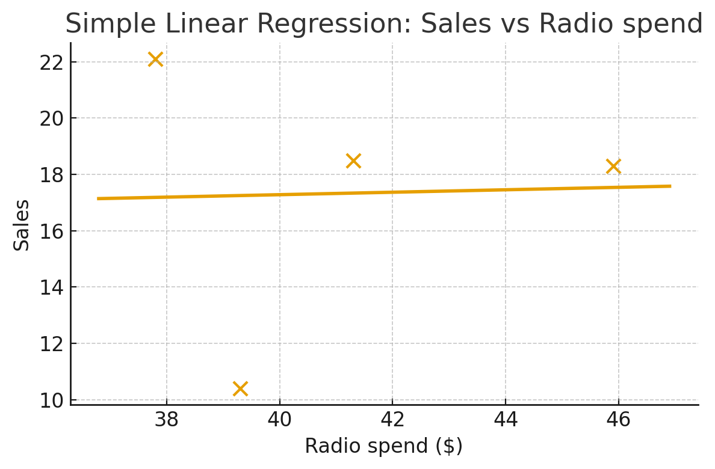


Step 4: Calculate Intercept b
$b=\overline{y}−w\overline{x}$
$$b=17.325−\left(0.0434\right)\left(41.075\right)≈15.54$$
Final Regression Equation: $\hat{y}=w.x+b$
$$\hat{y}=15.54+0.0434x$$
Step 5: Prediction Example
If a company spends $50 on radio ads:
$$\hat{y}=15.54+0.0434\left(50\right)≈17.71$$
So, predicted sales ≈ 17.7 units.
Company | Radio ($) | Actual Sales | Predicted Sales
Amazon | 37.8 | 22.1 | 17.182
Google | 39.3 | 10.4 | 17.248
Facebook | 45.9 | 18.3 | 17.535
Apple | 41.3 | 18.5 | 17.335
MSE = $\frac{1}{n}$ $\sum_{i=1}^{n}{\text{​}}{\left( y_{i} − \hat{y_{i}} \right)}^{2}$

Slide 8
x_i and y_i (for all i) -> Training dataset
y_hat = w . x_i+ b
Random values of w and b
w= 0.2 and b = .4 → w = 1 and b =.1
x_i = 4 and y_i = 5 ( training dataset)
y_hat = 0.2*4+0.4 = 1.2
Error = 1/n [sum over n (y_hat - y_i)^2] = 3.8

